Slide 1
.NET ASYNC PROGRAMMING (1/3)

Slide 2
TERMS
Thread (Process)
Parallel (multi-core)
Asynchronous

Slide 3
History
Thread (.NET Framework1.1)
ThreadPool (.NET Framework 1.1)
Task (.NET Framework 4.0)
TPL (.NET Framework 4.0)
Async (.NET Framework 4.5)

Slide 4
Questions
Difference between thread and task?
Difference between task and async ?

Slide 5
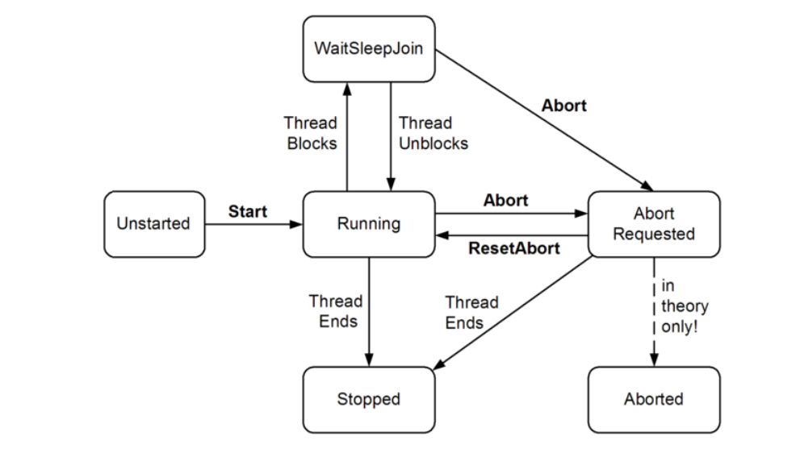
Thread - basics

Slide 6
Synchronization(1/4)- Simple blocking
Sleep, Join, Task.Wait

Slide 7
Synchronization(2/4)-Locking constructs
Exclusive lockings
Lock (Monitor.Enter/Monitor.Exit)
Mutex
SpinLock
Nonexclusive locking
Semaphore / SemaphoreSlim
Read/writer locks

Slide 8
Construct | Purpose | Cross-process? | Overhead*
lock (Monitor.Enter / Monitor.Exit) | Ensures just one thread can access a resource, or section of code at a time | - | 20ns
Mutex |  | Yes | 1000ns
SemaphoreSlim (introduced in Framework 4.0) | Ensures not more than a specified number of concurrent threads can access a resource, or section of code | - | 200ns
Semaphore |  | Yes | 1000ns
ReaderWriterLockSlim (introduced in Framework 3.5) | Allows multiple readers to coexist with a single writer | - | 40ns
ReaderWriterLock (effectively deprecated) |  | - | 100ns

Slide 9
Synchronization(3/4)-Signal constructs
Event wait handler
Monitor’s Wait/Pulse
CounddownEvent and Barrier(.NET 4.0)

Slide 10
Construct | Purpose | Cross-process? | Overhead*
AutoResetEvent | Allows a thread to unblock once when it receives a signal from another | Yes | 1000ns
ManualResetEvent | Allows a thread to unblock indefinitely when it receives a signal from another (until reset) | Yes | 1000ns
ManualResetEventSlim (introduced in Framework 4.0) |  | - | 40ns
CountdownEvent (introduced in Framework 4.0) | Allows a thread to unblock when it receives a predetermined number of signals | - | 40ns
Barrier (introduced in Framework 4.0) | Implements a thread execution barrier | - | 80ns
Wait and Pulse | Allows a thread to block until a custom condition is met | - | 120ns for a Pulse

Slide 11
Synchronization(4/4)-Nonblocking constructs
Thread.MemoryBarrier,
Volatile
Interlock

